Slide 1
Chapter 4
Data and Databases

Slide 2
Learning Objectives
Upon successful completion of this chapter, you will be able to:
Describe the differences between data, information, and technology
Define the term database and identify the steps to creating one
Describe the role of a database management system
Describe the characteristics of a data warehouse

Slide 3
Data, Information, and Knowledge
Data
Information
Knowledge
Wisdom
Data is raw bits and pieces of information
Quantitative – numeric
Qualitative – descriptive
Alone is not useful
Information is when data is given context and more specific
Knowledge is developed when information has been aggregated and analyzed to make decisions, set policies, and spark innovation.
Wisdom is the combination of knowledge and experience
May take years to develop

Slide 4
Databases
Organized collection of related information to generate knowledge for decision making purposes
For example, a university transcript database may contain information on students, classes taken, and grades received
A separate university database would be created to maintain your financial information
Relational databases (such as Microsoft Access) where data in organized into one or more tables
Tables are a collection of fields
E.g., Student ID, Course ID, Grade Earned
Record is an instance in the table
E.g., your specific information in the table

Slide 5
Databases continued

Slide 6
Database Design
Design is a critical first step in creating a database
Understand the goal of how the database will be used
Identify the data needed as part of accomplishing this goal
Identify how the data is related to each other
Identify tables and fields to organize the data
Each table needs a primary key of which field(s) is unique to each record and will not change
For example, our ID
Normalization is performed to eliminate duplicated data

Slide 7
Database Design
Each field in the database has a data type to store information:
Text – non-numeric data less than 256 characters
Number – numeric data
Yes/No – stores 0 for No or False and 1 for Yes or True
Date/Time – number data type that can be interpreted as a number or a time
Currency – monetary data
Paragraph Text – stores text longer than 256 characters
Object – data that can’t be typed such as a picture or music file
Data types functions can be performed on the data
For example, 2 number fields can be used to perform calculations
Data types indicate the amount of storage needed for each field

Slide 8
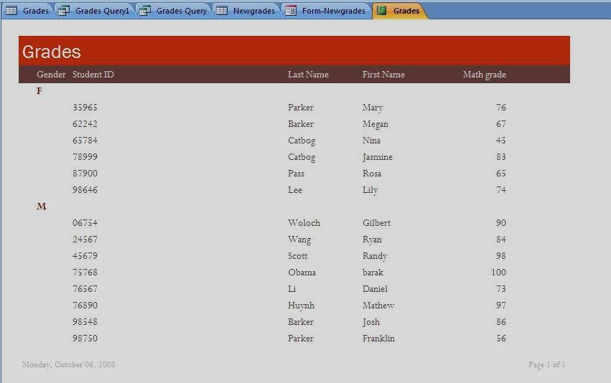
Database Reports
Structured Query Language (SQL) is a tool/language that helps extract information from the database for analysis purposes

Slide 9
Database Management Systems
Database Management Systems (DBMS) is an application that allows data to be:
Entered, Modified, and Deleted
Read
Reported
Has a user friendly interface to design the database
Relational databases use Microsoft Access installed on one machine with one user access at a time
Enterprise Databases serve the entire organization

Slide 10
Data Warehouse
Consists of extracts from one or more of the organization’s databases
Allows the data to be copied and stored for analysis
Needs to be refreshed as the data changes
Data is time-stamped when extracted
Allows comparisons between different time periods
Data is standardized
All similar fields (e.g., calendar dates) are structured the same
Date is MM/DD/YYYY
Data marts are smaller subsets of data warehouses for specific business problems

Slide 11
Data Warehouse Benefits
Forces organizations to better understand the data
Centralized view of data to identify inconsistent data
Once inconsistencies are resolved, higher quality data is used to make better business decisions
Data can be analyzed over multiple time periods
Tools are available to combine data and gain more insight into business operations

